Slide 1




Data Types
Text and Other Types, Variables
Data
SoftUni Team
Technical Trainers
Software University
http://softuni.bg

Slide 2

Table of Contents
Data Types
Characters and Strings
Variables
void
sbyte
ushort
double
int
float
ulong
byte
uint
long
short

Slide 3
Questions?
sli.do #fund-softuni

Slide 4

Data Types and Variables

Slide 5
Boolean Type
Boolean variables (bool) hold true or false:
int a = 1;
int b = 2;
bool greaterAB = (a > b);
Console.WriteLine(greaterAB); // False
bool equalA1 = (a == 1);
Console.WriteLine(equalA1); // True

Slide 6
Problem: Special Numbers
A number is special when its sum of digits is 5, 7 or 11
For all numbers 1…n print the number and if it is special
1 -> False
2 -> False
3 -> False
4 -> False
5 -> True
6 -> False
7 -> True
8 -> False
9 -> False
10 -> False
11 -> False
12 -> False
13 -> False
14 -> True
15 -> False
16 -> True
17 -> False
18 -> False
19 -> False
20 -> False
20
Check your solution here: https://judge.softuni.bg/Contests/Practice/Index/171#4
Notes:
Solution goes to note

Slide 7
Solution: Special Numbers
int n = int.Parse(Console.ReadLine());
for (int num = 1; num <= n; num++)
{
int sumOfDigits = 0;
int digits = num;
while (digits > 0)
{
sumOfDigits += digits % 10;
digits = digits / 10;
}
bool special = (sumOfDigits == 5) || …; // TODO: finish this
Console.WriteLine("{0} -> {1}", num, special);
}
Check your solution here: https://judge.softuni.bg/Contests/Practice/Index/171#4

Slide 8
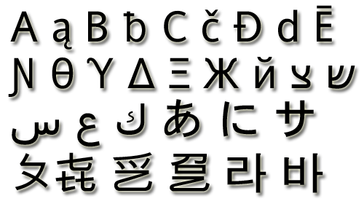
The Character Data Type
The character data type:
Represents symbolic information
Is declared by the char keyword
Gives each symbol a corresponding integer code
Has a '\0' default value
Takes 16 bits of memory (from U+0000 to U+FFFF)
Holds a single Unicode character (or part of character)

Slide 9
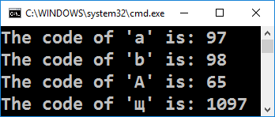
Characters and Codes
Each character has an unique Unicode value (int):
char ch = 'a';
Console.WriteLine("The code of '{0}' is: {1}", ch, (int) ch);
ch = 'b';
Console.WriteLine("The code of '{0}' is: {1}", ch, (int) ch);
ch = 'A';
Console.WriteLine("The code of '{0}' is: {1}", ch, (int) ch);
ch = 'щ'; // Cyrillic letter 'sht'
Console.WriteLine("The code of '{0}' is: {1}", ch, (int) ch);

Slide 10
Problem: Triples of Latin Letters
Write a program to read an integer n and print all triples of the first n small Latin letters, ordered alphabetically:
aaa
aab
aac
aba
abb
abc
aca
acb
acc
baa
bab
bac
bba
bbb
bbc
bca
bcb
bcc
caa
cab
cac
cba
cbb
cbc
cca
ccb
ccc
3
Check your solution here: https://judge.softuni.bg/Contests/Practice/Index/171#5
Notes:
Goes to exercise

Slide 11
Solution: Triples of Latin Letters
int n = int.Parse(Console.ReadLine());
for (int i1 = 0; i1 < n; i1++)
for (int i2 = 0; i2 < n; i2++)
for (int i3 = 0; i3 < n; i3++)
{
char letter1 = (char)('a' + i1);
char letter2 = // TODO: finish this
char letter3 = // TODO: finish this
Console.WriteLine("{0}{1}{2}",
letter1, letter2, letter3);
}
Check your solution here: https://judge.softuni.bg/Contests/Practice/Index/171#5

Slide 12
Escaping Characters
Escaping sequences are:
Represent a special character like ', " or \n (new line)
Represent system characters (like the [TAB] character \t)
Commonly used escaping sequences are:
\' → for single quote \" → for double quote
\\ → for backslash \n → for new line
\uXXXX → for denoting any other Unicode symbol

Slide 13
Character Literals – Example
char symbol = 'a'; // An ordinary character
symbol = '\u006F'; // Unicode character code in a
// hexadecimal format (letter 'o')
symbol = '\u8449'; // 葉 (Leaf in Traditional Chinese)
symbol = '\''; // Assigning the single quote character
symbol = '\\'; // Assigning the backslash character
symbol = '\n'; // Assigning new line character
symbol = '\t'; // Assigning TAB character
symbol = "a"; // Incorrect: use single quotes!

Slide 14

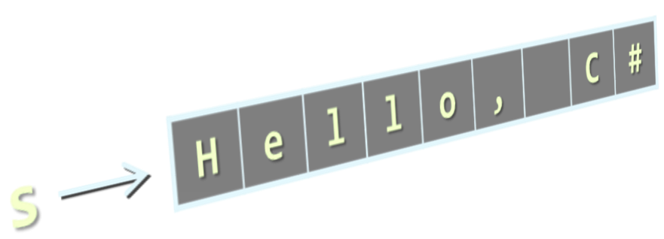
The String Data Type
The string data type:
Represents a sequence of characters
Is declared by the string keyword
Has a default value null (no value)
Strings are enclosed in quotes:
Strings can be concatenated
Using the + operator
string
string s = "Hello, C#";

Slide 15
Verbatim and Interpolated Strings
Strings are enclosed in quotes "":
Strings can be verbatim (no escaping):
Interpolated strings insert variable values by pattern:
The backslash \ is escaped by \\
string file = "C:\\Windows\\win.ini";
The backslash \ is not escaped
string file = @"C:\Windows\win.ini";
string firstName = "Svetlin";
string lastName = "Nakov";
string fullName = $"{firstName} {lastName}";

Slide 16
Saying Hello – Examples
Combining the names of a person to obtain the full name:
We can concatenate strings and numbers by the + operator:
string firstName = "Ivan";
string lastName = "Ivanov";
Console.WriteLine(@"Hello, ""{0}""!", firstName);
string fullName = $"{firstName} {lastName}";
Console.WriteLine("Your full name is {0}.", fullName);
int age = 21;
Console.WriteLine("Hello, I am " + age + " years old");

Slide 17
Problem: Greeting by Name and Age
Write a program that enters first name, last name and age and prints "Hello, <first name> <last name>. You are <age> years old."
string firstName = Console.ReadLine();
string lastName = Console.ReadLine();
string ageStr = Console.ReadLine();
int age = int.Parse(ageStr); // Parse string → int
Console.WriteLine($"Hello, {firstName} {lastName}.\r\nYou are {age} years old.");
Check your solution here: https://judge.softuni.bg/Contests/Practice/Index/171#6

Slide 18

Data Types
string
(int) value
bool
switch
case
char
Live Exercises in Class (Lab)

Slide 19
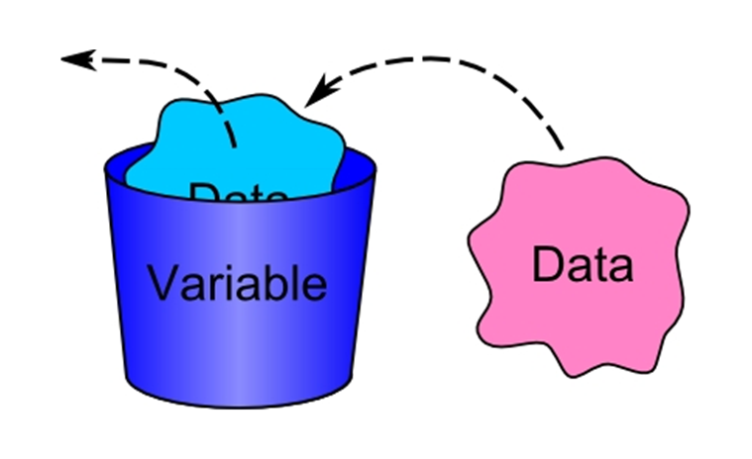
Variables

Slide 20
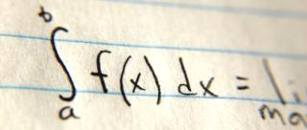


Naming Variables
Variable names
Always refer to the naming conventions of a programming language – for C# use camelCase
Preferred form: [Noun] or [Adjective] + [Noun]
Should explain the purpose of the variable (Always ask yourself "What this variable contains?")
firstName, report, config, usersList, fontSize, maxSpeed
foo, bar, p, p1, p2, populate, LastName, last_name, LAST_NAME

Slide 21
Problem: Refactor Volume of Pyramid
You are given a working code that finds the volume of a prism:
Fix naming, span and multi-purpose variables
double dul, sh, V = 0;
Console.Write("Length: ");
dul = double.Parse(Console.ReadLine());
Console.Write("Width: ");
sh = double.Parse(Console.ReadLine());
Console.Write("Height: ");
V = double.Parse(Console.ReadLine());
V = (dul * sh * V) / 3;
Console.WriteLine("Pyramid Volume: {0:F2}", V);
Check your solution here: https://judge.softuni.bg/Contests/Practice/Index/171#7

Slide 22
Variable Scope and Lifetime
Scope shows from where you can access a variable
Lifetime shows how long a variable stays in memory
Accessible in the Main()
static void Main()
{
var outer = "I'm inside the Main()";
for (int i = 0; i < 10; i++)
{
var inner = "I'm inside the loop";
}
Console.WriteLine(outer);
// Console.WriteLine(inner); // Error
}
Accessible in the loop

Slide 23
Variable Span
Variable span is how long before a variable is called
Always declare a variable as late as possible (e.g. shorter span)
static void Main()
{
var outer = "I'm inside the Main()";
for (int i = 0; i < 10; i++)
{
var inner = "I'm inside the loop";
}
Console.WriteLine(outer);
// Console.WriteLine(inner); // Error
}
"outer" variable span

Slide 24
Variable Span
Variable span is how long before a variable is called
Always declare a variable as late as possible (e.g. shorter span)
static void Main()
{
for (int i = 0; i < 10; i++)
{
var inner = "I'm inside the loop";
}
var outer = "I'm inside the Main()";
Console.WriteLine(outer);
// Console.WriteLine(inner); // Error
}
"outer" variable span

Slide 25
Problem: Refactor Special Numbers
int kolkko = int.Parse(Console.ReadLine());
int obshto = 0; int takova = 0; bool toe = false;
for (int ch = 1; ch <= kolkko; ch++)
{
takova = ch;
while (ch > 0)
{
obshto += ch % 10;
ch = ch / 10;
}
toe = (obshto == 5) || (obshto == 7) || (obshto == 11);
Console.WriteLine($"{takova} -> {toe}");
obshto = 0; ch = takova;
}
Check your solution here: https://judge.softuni.bg/Contests/Practice/Index/171#8

Slide 26
Variables
string
(int) value
bool
switch
case
char
Live Exercises in Class (Lab)

Slide 27

Summary
Classical data types:
Character and String: Represent symbolic and text information
Variables – Store information
Have scope, span and lifetime

Slide 28









Data Types
https://softuni.bg/courses/programming-fundamentals

Slide 29
License
This course (slides, examples, demos, videos, homework, etc.) is licensed under the "Creative Commons Attribution-NonCommercial-ShareAlike 4.0 International" license
Attribution: this work may contain portions from
"Fundamentals of Computer Programming with C#" book by Svetlin Nakov & Co. under CC-BY-SA license

Slide 30






Free Trainings @ Software University
Software University Foundation – softuni.org
Software University – High-Quality Education, Profession and Job for Software Developers
softuni.bg
Software University @ Facebook
facebook.com/SoftwareUniversity
Software University @ YouTube
youtube.com/SoftwareUniversity
Software University Forums – forum.softuni.bg

